Slide 1
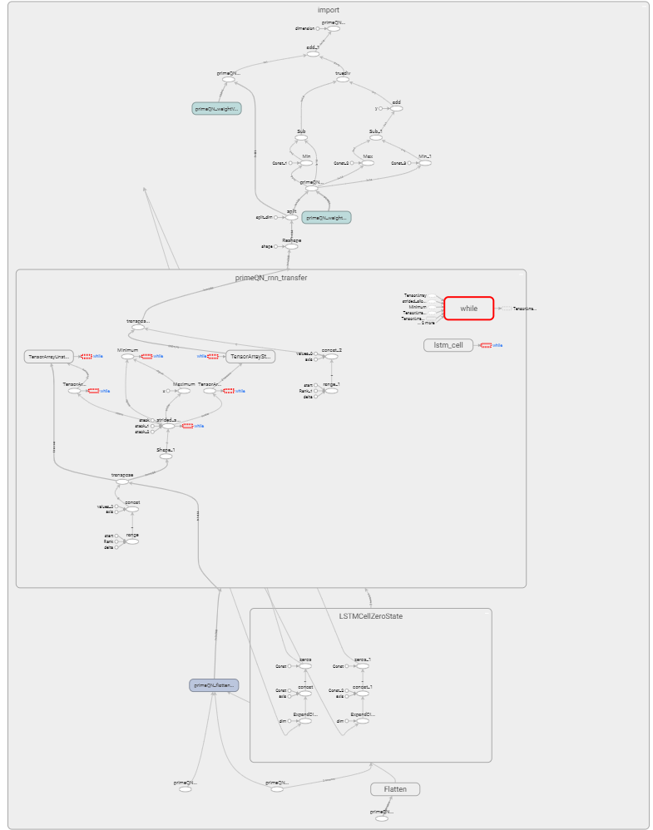
This is RL Architeture

Slide 2
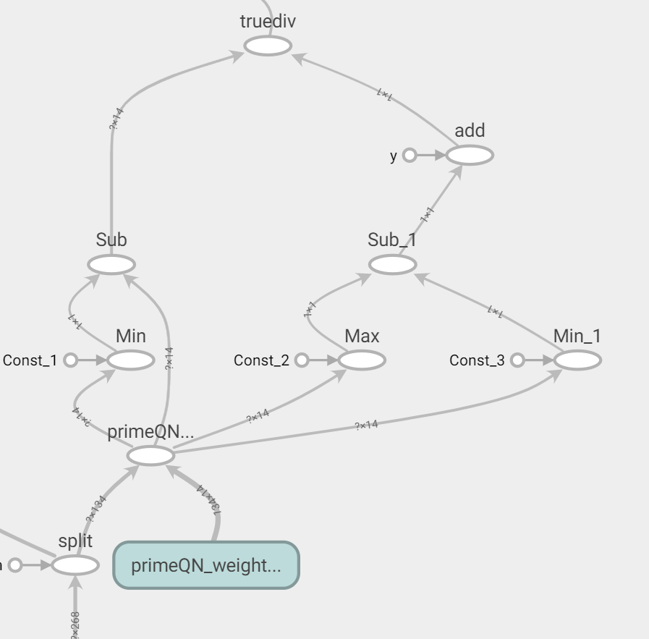
This is a sample layers are not supported on VPU

Slide 3
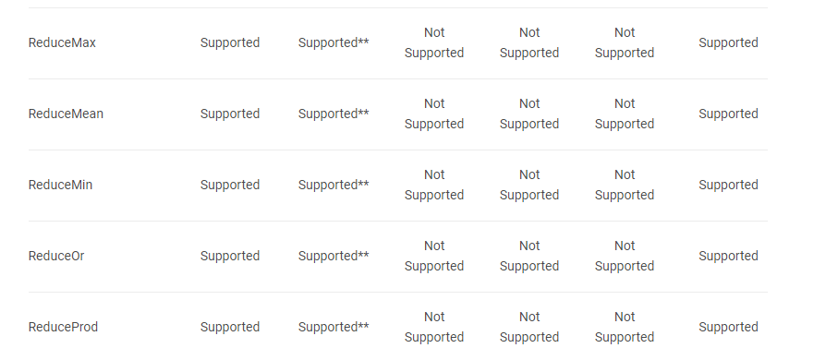
Reference :
https://docs.openvinotoolkit.org/latest/_docs_IE_DG_supported_plugins_Supported_Devices.html#supported_layers

